Slide 1

DASHBOARD AUTOMATION PROJECT
Natalia Sanchez
Fernando Carrillo
Edgardo MaTtos
Manuel Pinedo

Slide 2
Introduction
Automation
Facilitate seamless collaboration and information exchange between departments.
Project aim:
Automate the process of consolidating new information.
Streamline the entire analysis and reporting workflow.
Emphasize flexibility for regular updates.
Ensure the timely and accurate flow of information within the organization.
Charts and Dashboards.
Gantt Chart
Notes:
The primary objective of our project is to automate the process of consolidating new information as it is updated and to streamline the entire process throughout the analysis and reporting workflow.

Slide 3
Overview
Manual process:
Extraction of data from operative database into Excel.
Simulation of data insertion typically done by an application.
Automated solution:
Implementation of a Python-based system.
Emulation of application data insertion.
Seamless integration with analytical database.
Significance of frequent updates:
Ensures timely emulation of data insertion.
Provides real-time insights.
Maintains synchronization between databases.

Slide 4
Modified Analysis and Tables
Dynamic adaptability: Automation ensures evolution with each update. Real-time and accurate representation of data.
Real-time reporting: Automation extends to dashboard creation. Stakeholders receive timely insights.

Slide 5
Benefits
Significant time savings.
Reduced errors.
Improved decision-making with current and accurate data.

Slide 6

Relevant Project Information
Phyton, SQL and Excel are the tools used for the automation.

Slide 7
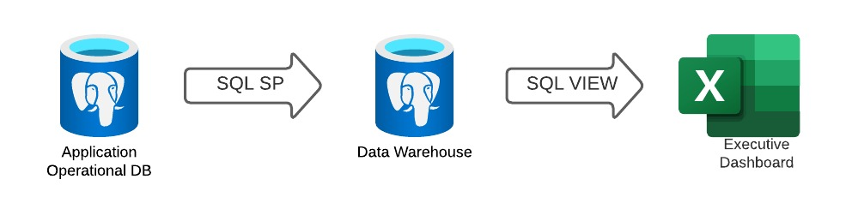
Automation Workflow

Slide 8

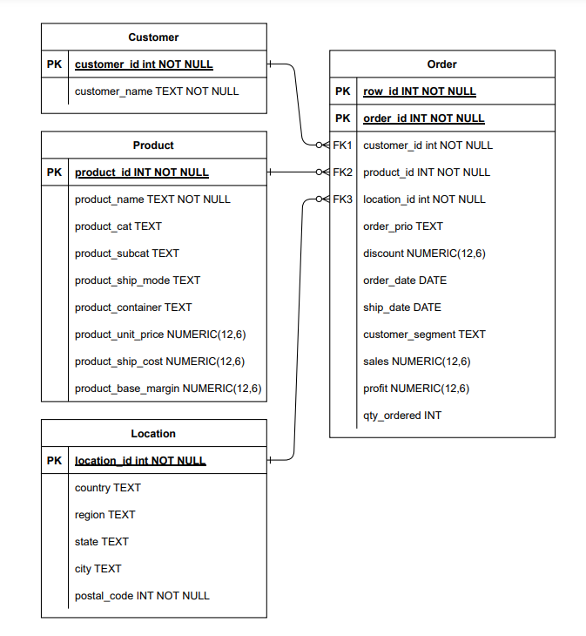
Data Warehouse Schema

Slide 9
Project Management
Gantt Chart
Present the concept of generating real-time reports.
Emphasize the significance of having up-to-date information for decision-making.

Slide 10
Next Steps
API Layer to request data from a life Data Base to a Data Warehouse
Use of a time scheduler like Cron for Linux, Task Scheduler, Power Automate, etc.
Catching errors.
Another way to create an automation workflow to refresh our data Base it would be use Watch dogs, a library from Python.

Slide 11

Thank YOU!

